Slide 1


AWS MANAGED SERVICE
AWS Amazon MQ
Managed Message Broker Service
Cloud Messaging Solution for Enterprise Applications
AWS Technical Presentation Series
Presented By Vignesh Adlagatta

Slide 2
AGENDA
Introduction to Messaging Systems
Setup, Security & Network Configuration
What is Amazon MQ & Why Use It
AWS Service Integrations
Broker Engines: ActiveMQ & RabbitMQ
Real-World Use Cases & Monitoring
Architecture & Deployment Modes
Best Practices & Summary

Slide 3
Section 1
Introduction to Cloud Messaging

Slide 4






WHAT IS MESSAGING MIDDLEWARE?
Distributed Apps
Decoupling
Asynchronous
Enables communication between geographically dispersed or logicially separated components.
Decouples producers from consumers so they don't need to be online at the same time.
Improves scalability and reliability by allowing non-blocking communication flows.

Slide 5

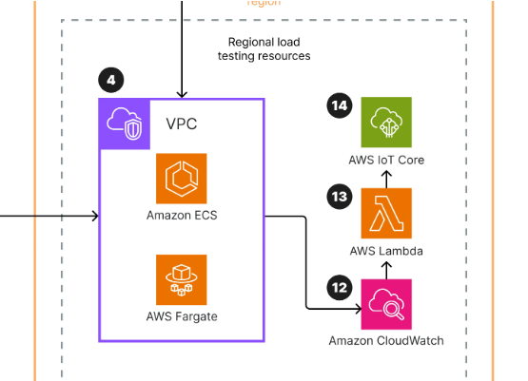
PROBLEMS WITHOUT BROKERS
Tight Coupling: Services are directly dependent on each other.
Poor Scalability: Synchronous calls bottleneck the entire system.
Failure Handling: If the receiver is down, the message is lost.
Latency: Users wait for downstream processes to finish.

Slide 6
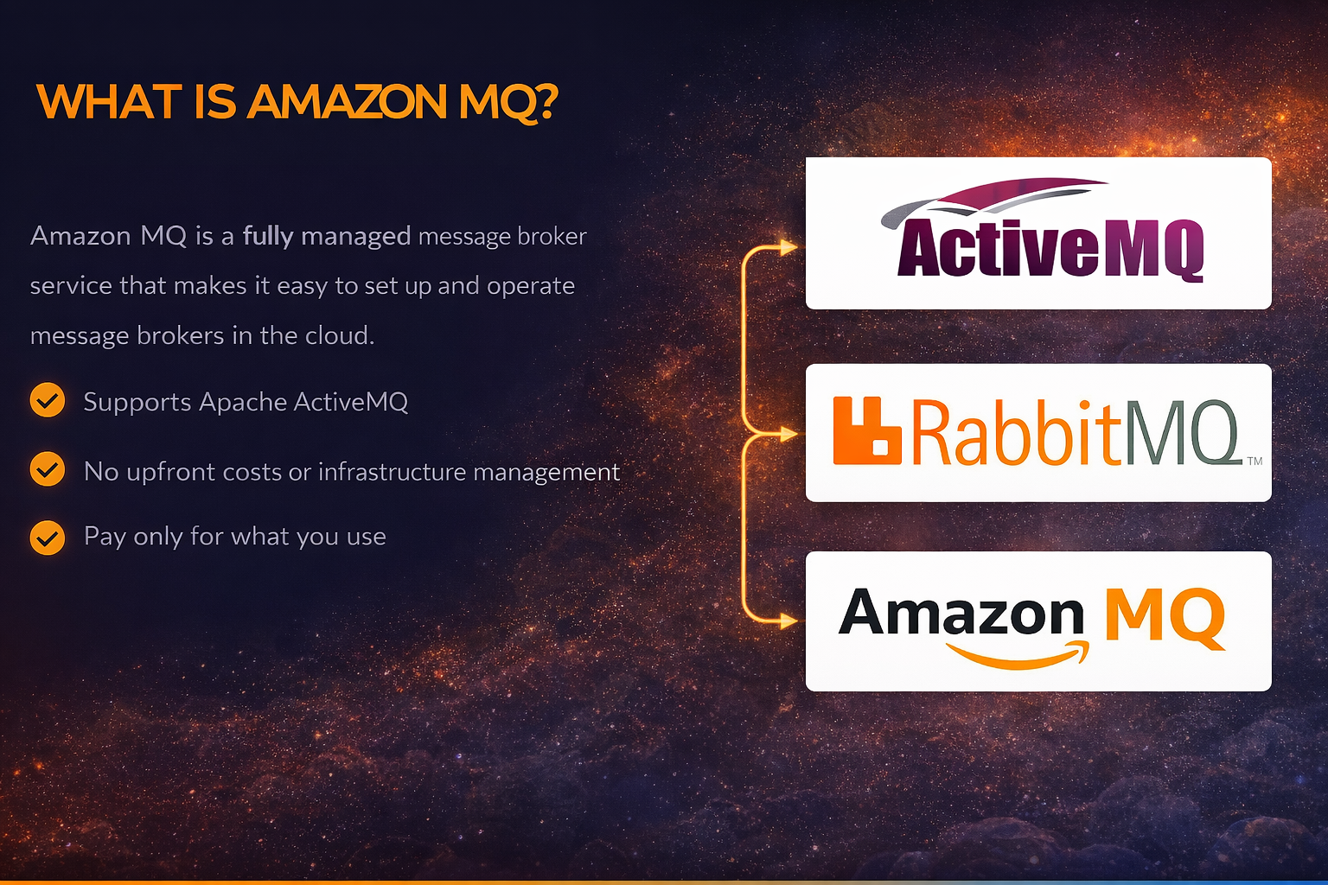

Slide 7






KEY BENEFITS
Fully Managed
Secure
Migration
AWS handles patching, setup, and maintenance automatically.
Encryption at rest and in transit. VPC integration for isolation.
Easy migration for legacy apps using standard APIs like JMS and AMQP.

Slide 8
Section 2
Messaging Concepts

Slide 9
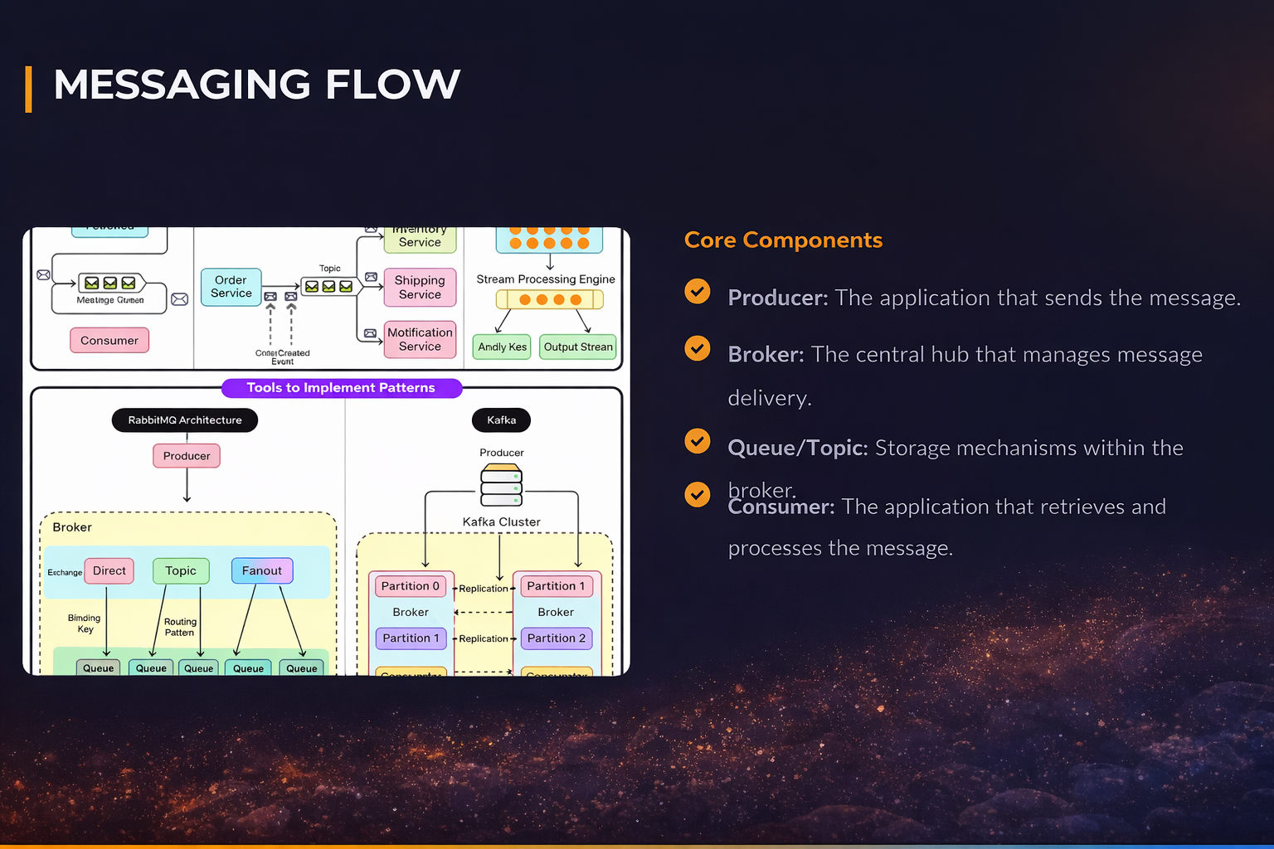
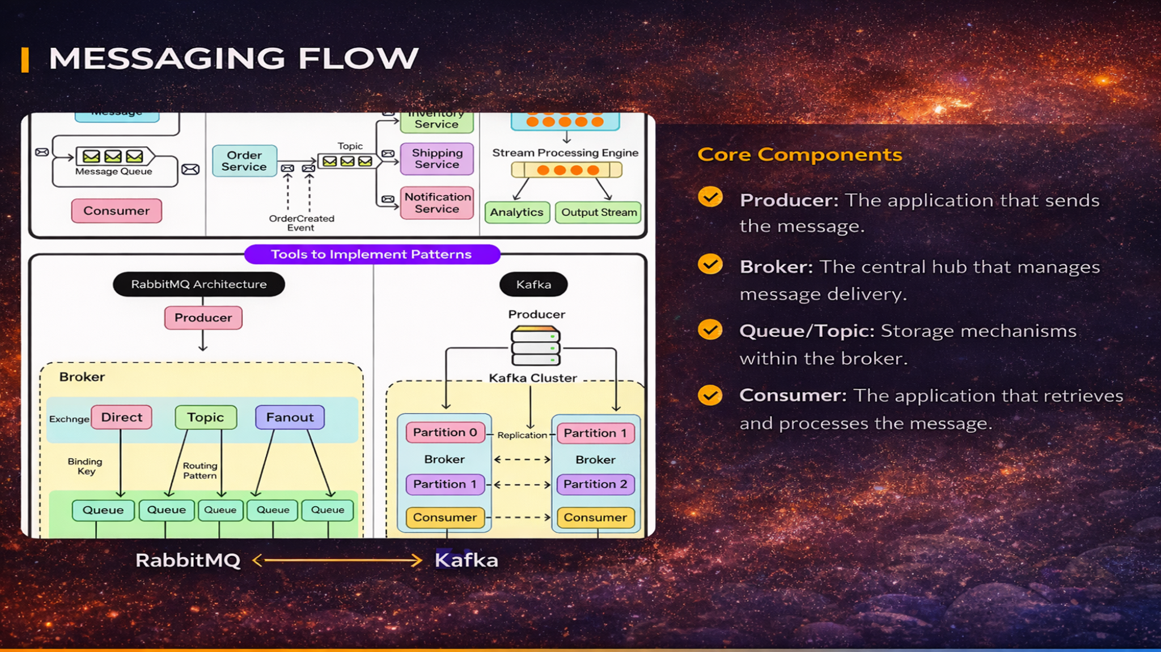

Slide 10


QUEUE VS. TOPIC
The Queue
The Topic
Point-to-Point Messaging
Publish / Subscribe Model
Messages are sent to one specific queue. Only one consumer receives and processes a specific message. Perfect for task distribution.
Messages are published to a topic. Multiple consumers (subscribers) can receive the same message simultaneously. Ideal for event broadcasting.

Slide 11
Section 3
Amazon MQ Features

Slide 12
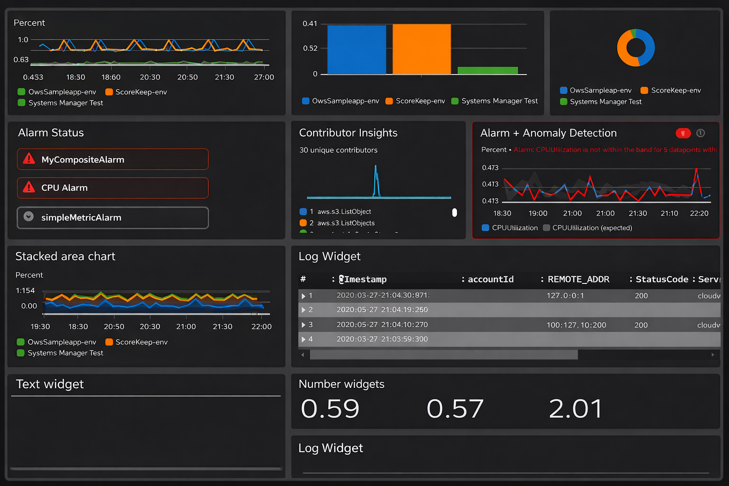

NATIVE FEATURES
Engine Support: ActiveMQ and RabbitMQ.
Durability: Messages are stored across multiple Availability Zones.
Auto-Backups: Managed snapshots for recovery.
Integration: Seamless with CloudWatch metrics.

Slide 13
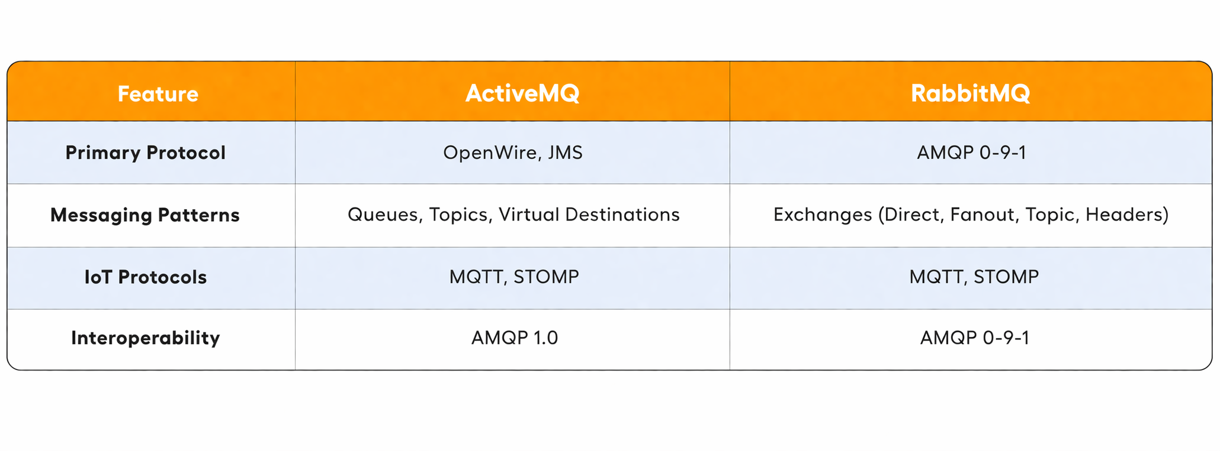
SUPPORTED PROTOCOLS

Slide 14



AMAZON MQ USE CASES
Microservices
Financial Systems
Order Processing
Decoupling complex service architectures into manageable components.
Ensuring transactional integrity and message ordering in banking.
Managing high-volume asynchronous tasks like inventory updates.

Slide 15
Section 4
Broker Architecture

Slide 16
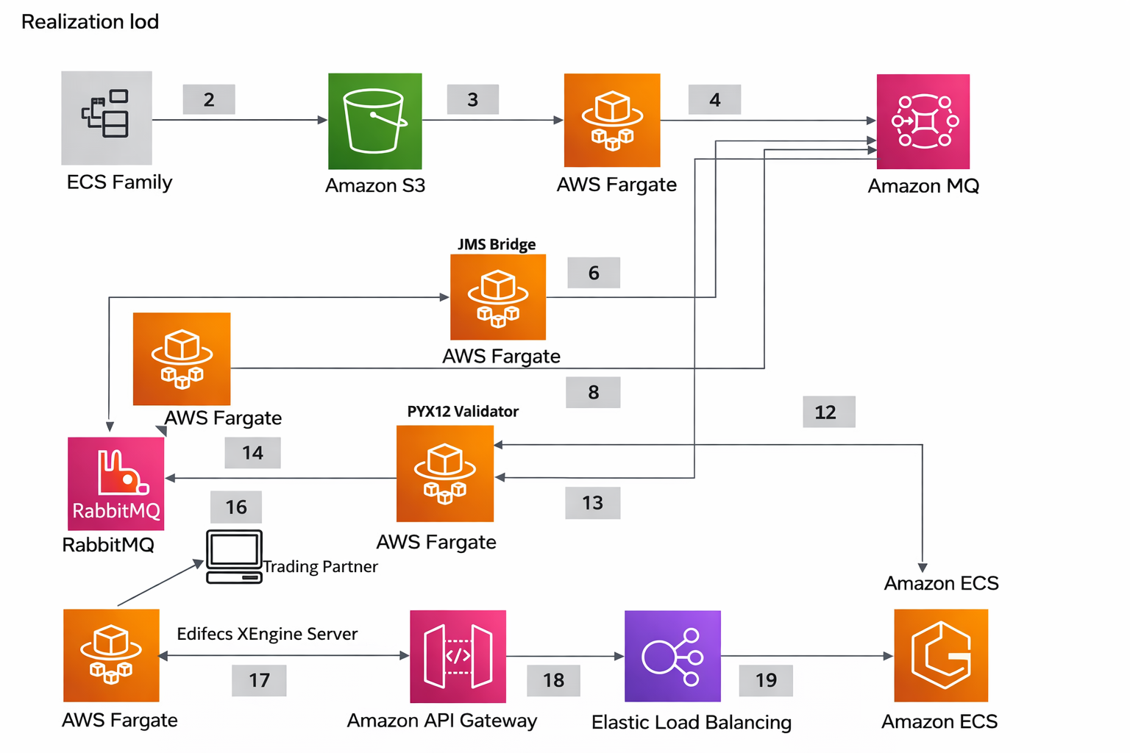
SYSTEM ARCHITECTURE
The architecture consists of clients connecting to a managed broker instance within a VPC. The broker communicates with specialized storage and logging layers.
Elastic Network Interface (ENI)
Security Group Layer
High-availability Storage

Slide 17



BROKER COMPONENTS
The Instance
Storage Layer
Endpoints
The virtual compute resource running the message broker engine.
Where messages are stored (EBS or EFS depending on HA needs).
Unique URLs provided per protocol (e.g., ssl://broker-id.mq.region.amazonaws.com:61617).

Slide 18
SINGLE INSTANCE DEPLOYMENT
Development & Testing
Consists of one broker in one Availability Zone.
Lowest cost option.
No high availability (single point of failure).
Recommended for non-production environments.

Slide 19
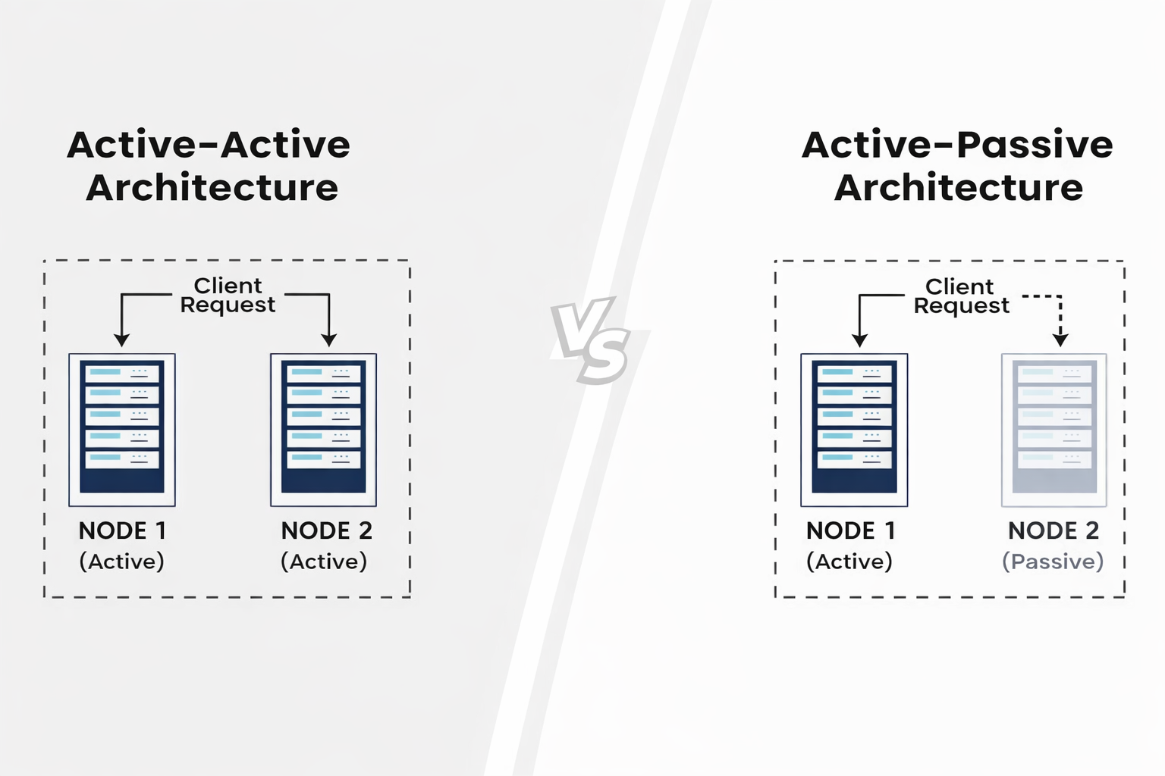

ACTIVE / STANDBY DEPLOYMENT
Production High Availability
Two brokers in different AZs sharing redundant storage.
Automatic failover if Active broker fails.
Ensures zero message loss with replicated storage.
Standard for critical enterprise workloads.

Slide 20
Section 5
Amazon MQ Setup

Slide 21
CREATING A BROKER
Step 1: Navigate to Amazon MQ in the AWS Management Console.
Step 2: Click "Create Broker" and select your engine (ActiveMQ/RabbitMQ).
Step 3: Select Deployment Mode (Single or Active/Standby).
Step 4: Configure instance size (mq.t3.micro up to mq.m5.large).
Step 5: Review and Launch.

Slide 22
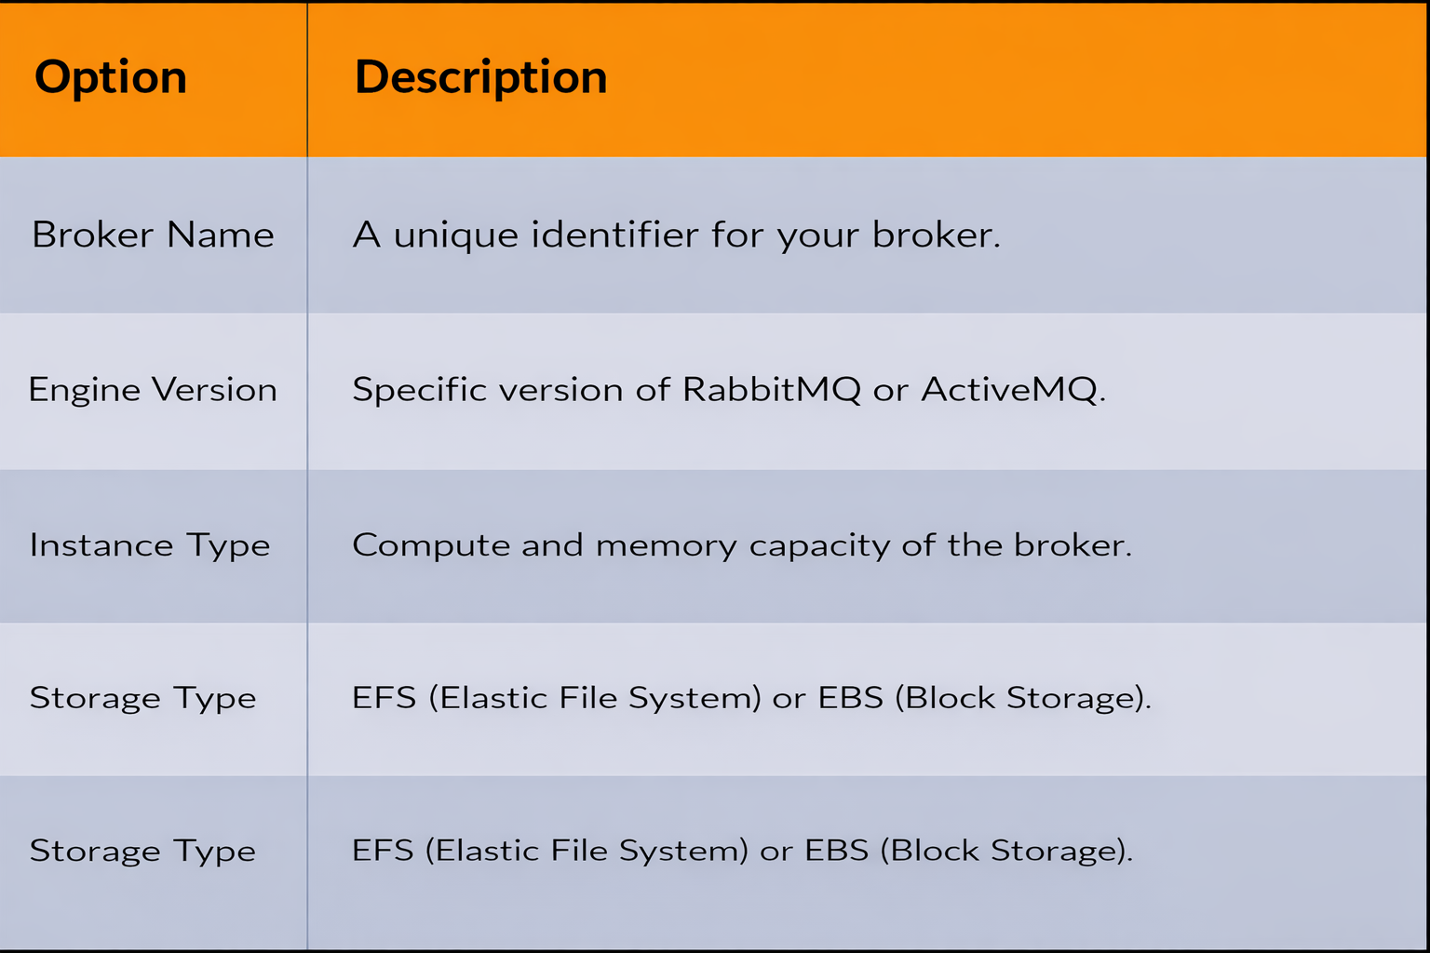
BROKER CONFIGURATION

Slide 23


NETWORK CONFIGURATION
VPC & Subnets
Security Groups
The broker should be placed in a Private Subnet for security. It interacts with other services via ENIs.
Must allow inbound traffic on specific protocol ports (e.g., 5671 for RabbitMQ AMQP/SSL).

Slide 24
AUTHENTICATION SETUP
Console Credentials: Username and password for the management console.
Application Credentials: Separate credentials for producer/consumer connectivity.
IAM Integration: Use AWS IAM to control who can create or delete brokers.
Active Directory: Integration available for complex ActiveMQ auth requirements.

Slide 25



BROKER ACCESS METHODS
SDK / CLI
Client Libs
Web Console
Managing the broker infrastructure via AWS SDKs or CLI commands.
Standard libraries (Pika, JMS) connecting to wire-level endpoints.
Native ActiveMQ or RabbitMQ dashboard for queue monitoring.

Slide 26
Section 6
AWS Integrations

Slide 27



INTEGRATION WITH AWS ECOSYSTEM
AWS Lambda
EC2 / ECS
CloudWatch
Trigger functions based on message arrivals in the queue.
Run persistent worker applications that consume messages.
Centralized logging and alerting for broker health.

Slide 28
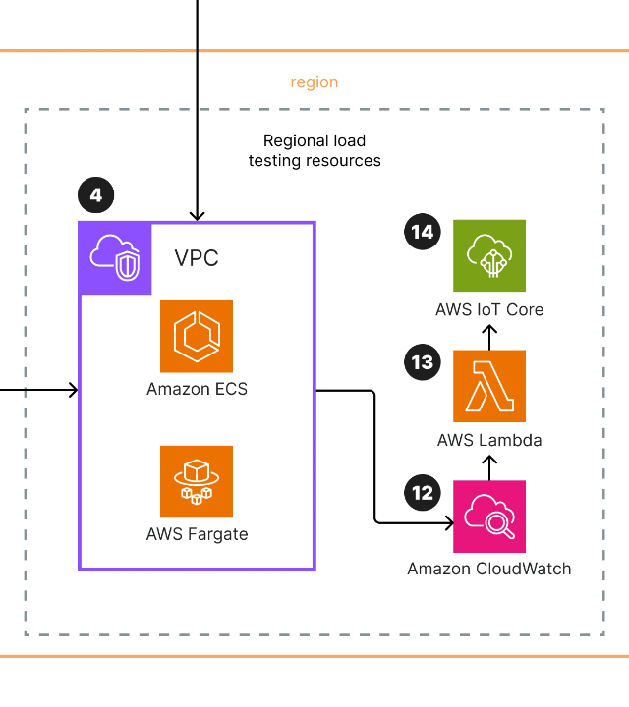
INTEGRATION ARCHITECTURE
Modern applications use Amazon MQ to glue together serverless functions and containerized workloads. The message broker acts as the persistent state for inter-service communication.

Slide 29
Section 7
Example Workflows

Slide 30
ORDER PROCESSING WORKFLOW
1. Checkout
2. Publish
3. Process
4. Update
Customer places order on website.
Order service sends message to MQ.
Payment service pulls from queue.
Database updated, shipping notified.

Slide 31
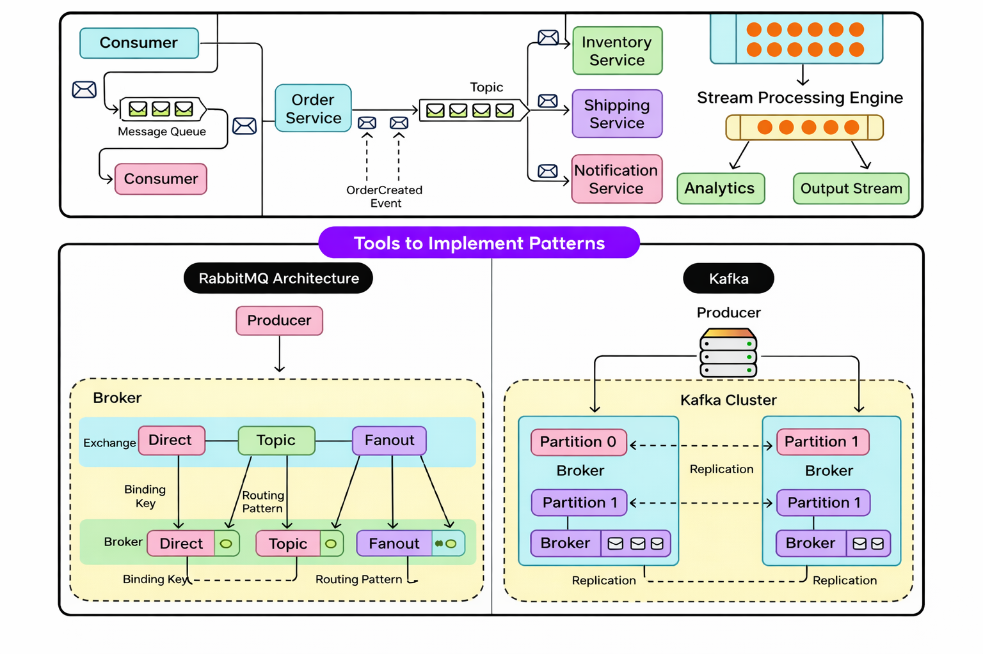
MESSAGE LIFECYCLE
Ingress: Message is validated and persisted to storage.
In-Flight: Message sits in the queue awaiting a consumer.
Egress: Consumer pulls message and sends Acknowledgment (ACK).
Cleanup: ACK'd message is removed from the broker.

Slide 32
Section 8
Code Examples

Slide 33
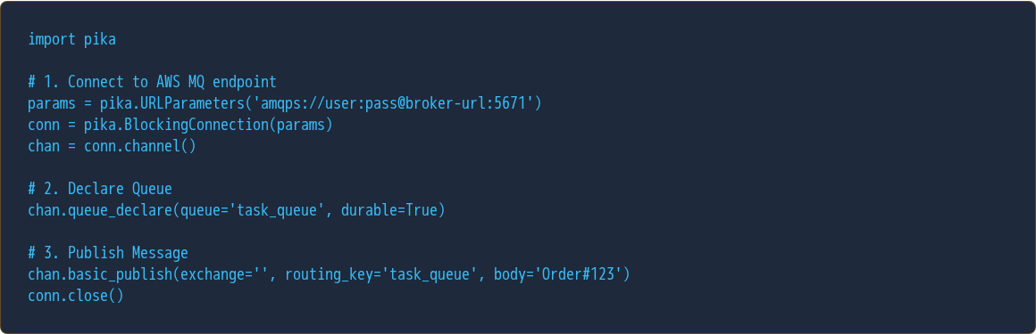
PYTHON PRODUCER (RABBITMQ)

Slide 34
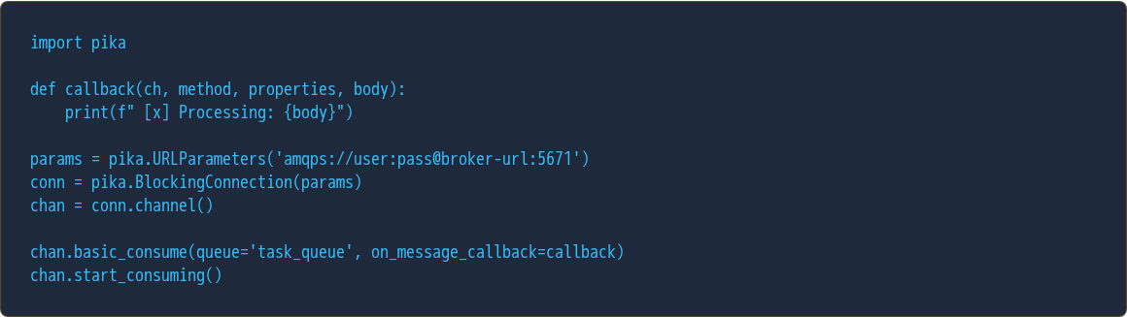
PYTHON CONSUMER (RABBITMQ)

Slide 35
Section 9
Security & Compliance

Slide 36


AMAZON MQ SECURITY
Network Security
Identity Management
VPC integration ensures your broker is not accessible from the public internet by default. Use Security Groups to whitelist specific IP ranges.
Integrate with AWS IAM for API-level control. Use built-in ActiveMQ or RabbitMQ auth for application-level authentication.

Slide 37

DATA ENCRYPTION
In-Transit: All communication uses SSL/TLS encryption protocols.
At-Rest: Messages in storage are encrypted using AWS KMS keys.
KMS Keys: Choose between AWS-managed keys or customer-managed (CMKs) for full control.

Slide 38
Thank You
Questions?
Amazon MQ: The bridge to scalable, decoupled cloud applications.
For more info, visit aws.amazon.com/amazon-mq

Slide 39






IMAGE SOURCES
https://images.ctfassets.net/w6r2i5d8q73s/1eZleaHU0CqxxIk1XHgmud/c1431dc9b5b81dc28e5c4141718dfc8d/1.png?fm=webp&q=75
Source: miro.com
https://media2.dev.to/dynamic/image/width=1080,height=1080,fit=cover,gravity=auto,format=auto/https%3A%2F%2Fdev-to-uploads.s3.amazonaws.com%2Fuploads%2Farticles%2Fc3l6t9pwh8glmkdajrtv.png
Source: dev.to
https://substackcdn.com/image/fetch/$s_!3jiz!,w_1456,c_limit,f_auto,q_auto:good,fl_progressive:steep/https%3A%2F%2Fsubstack-post-media.s3.amazonaws.com%2Fpublic%2Fimages%2F81ccfded-9aa1-43fe-9888-aff03bc92b03_2250x2624.heic
Source: blog.bytebytego.com
https://d2908q01vomqb2.cloudfront.net/972a67c48192728a34979d9a35164c1295401b71/2020/10/15/Sampledashboard.png
Source: aws.amazon.com
https://d2908q01vomqb2.cloudfront.net/fc074d501302eb2b93e2554793fcaf50b3bf7291/2022/04/08/RAD-486-1024x587.png
Source: aws.amazon.com
https://media.geeksforgeeks.org/wp-content/uploads/20240423165007/Active-Active-vs-Active-Passive-Architecture.webp
Source: www.geeksforgeeks.org

Slide 40

IMAGE SOURCES
https://www.dilitrust.com/wp-content/uploads/how-secure-your-contract.webp
Source: www.dilitrust.com

